Slide 1
Ensuring Inclusiveness through Space-based Applications and Space Exploration
Shirish Ravan
United Nations Office for Outer Space Affairs
Shirish.ravan@un.org

Slide 2
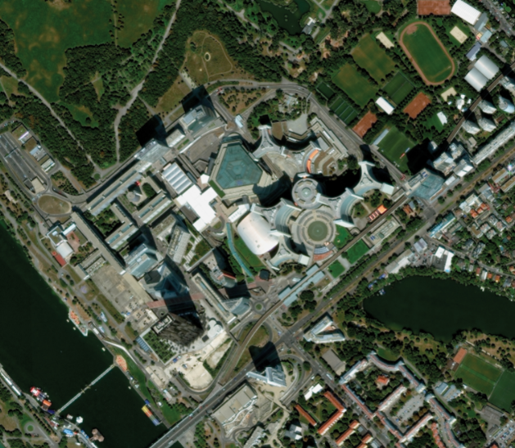
United Nations Office for Outer Space Affairs (UNOOSA)
Vision
Bringing the benefits of space to humankind
Mission Statement
Promote international cooperation in the peaceful uses of outer space to achieve sustainable development goals
Image credit: Digital Globe/Maxar Technologies

Slide 3

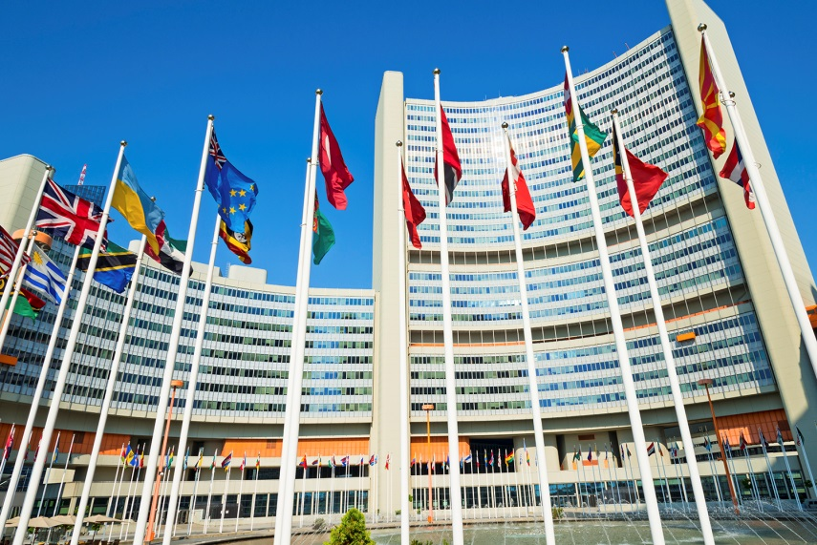
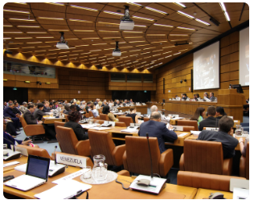
  Secretariat to the
  UN Committee on the Peaceful Uses of Outer Space (COPUOS)

Slide 4


Main programmes and platforms
  Programme on Space Applications
  UN-wide coordination on space affairs - UN-Space
  UN Register of Space Objects
  UN-SPIDER (Disaster Management and Emergency Response)
  International Committee on Global Navigation Satellite Systems (ICG)
  Space Mission Planning Advisory Group (SMPAG)
  www.unoosa.org; www.un-spider.org
Notes:
The space solutions compendium is a list of space-related solutions that each country can apply in accordance with its space strategy
The compendium is a key tool for supporting the 2030 Agenda for Sustainable Development, linking space solutions with SDG goals and targets.
Through the compendium, UNOOSA would act as a focal point, pairing solutions provided by developed and developing countries, monitoring the effectiveness of those solutions and identifying user needs to deliver more targeted capacity-building

Slide 5
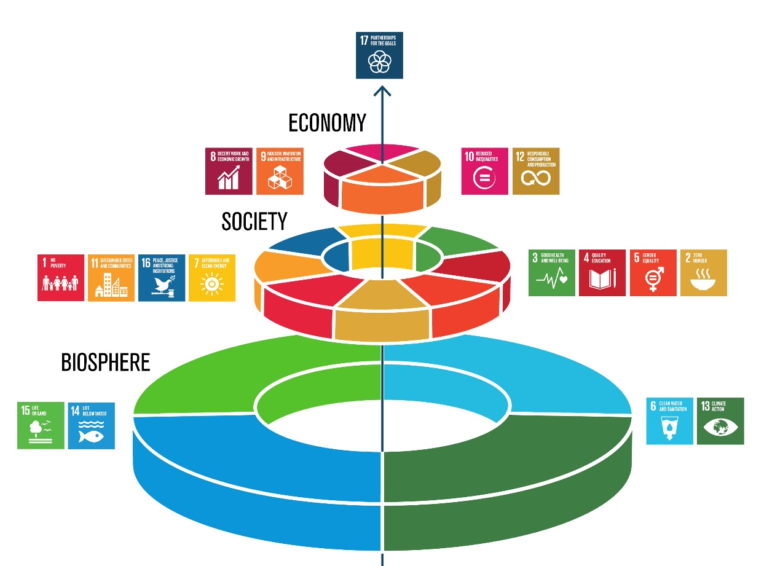
"The 2030 Agenda is our roadmap and its goals and targets are tools to get there.", - Secretary-General António Guterres
The Sustainable Development Goals are the blueprint to achieve a better and more sustainable future for all.
They address the global challenges we face
poverty,
inequality,
climate,
environmental degradation,
prosperity, and
peace and justice.
Universality Integration Transformation

Slide 6
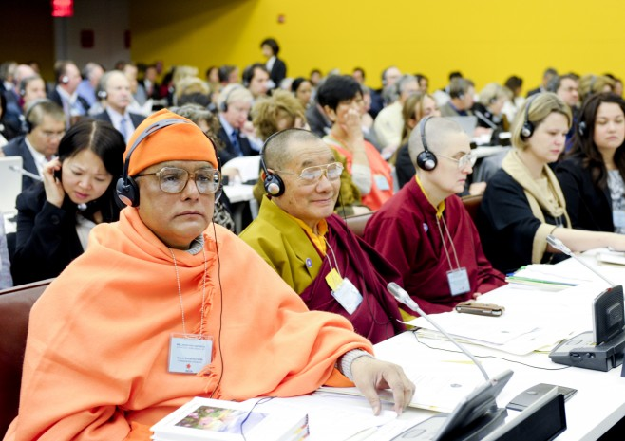
‘INCLUSIVENESS’ IS THE KEY TO IMPLEMENTING THE SDGS
The SDGs provide two key operational principles
'universality' and
'leaving no one behind’
Challenge is to embody these principles in practice
The way to promote inclusiveness and equality through space applications and exploration is intrinsically related to the SDGs itself.

Slide 7
HIGH-LEVEL POLITICAL FORUM 2019
"Empowering people and ensuring inclusiveness and equality"
The first four-year cycle of its mandate to review the 17 SDGs and assess progress
Key points:
SDG 4 (quality education) is battling a “global learning crisis”
SDG 8 (decent work and economic growth) “progress on slow and uneven”;
SDG 10 (reduced inequalities) - income inequality is on the rise;
SDG 13 (climate action) - climate change is disrupting national economies and affecting lives;
SDG 16 (peace, justice, and strong institutions) - no substantial progress has been made on the targets.
On SDG 17 (partnerships for the goals) - official development assistance (ODA) is down by 2.7% in 2018 compared to 2017, humanitarian aid fell by 8% in the same period, and aid to the least developed countries and African countries, who need it most, is falling.

Slide 8
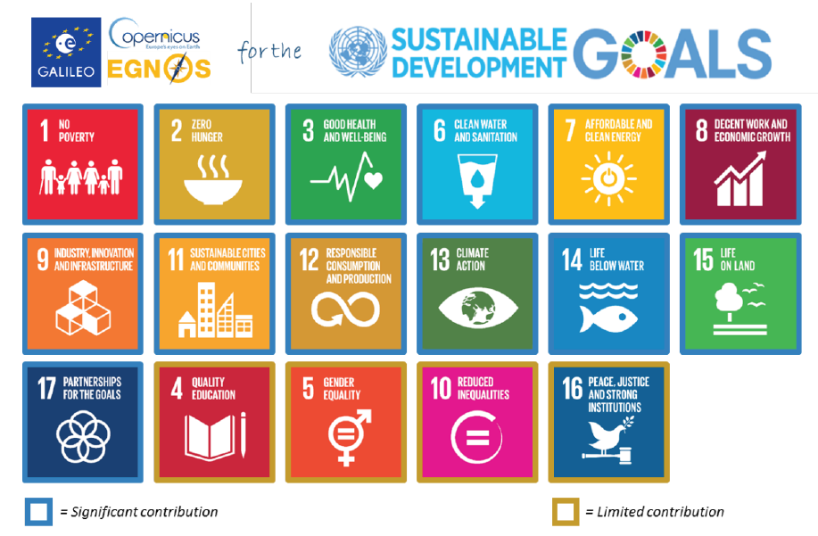

Space for SDGs
The role of space applications and exploration is increasing in strengthening cooperation across all sectors related to sustainable development,
particularly in the context of developing countries.
17 Goals, 169 Targets, 232 Indicators

Slide 9
Illgasse 44, 1210 Wien
Workshop – A platform to ensure inclusive development in the areas of space technologies taking people, students, private sectors, researchers, academia, innovators and other actors on board in bringing benefits of space to the end users
Provide insight on how space applications contribute to empowering people and ensuring inclusiveness and equality
Demonstrate success stories of space applications for SDGs with focus on inclusiveness and equality
Promote and discuss inclusiveness on space exploration
Raise awareness on the efforts of the international space community on how space exploration and innovations can trigger inclusiveness through new partnerships involving space emerging nations and industries

Slide 10
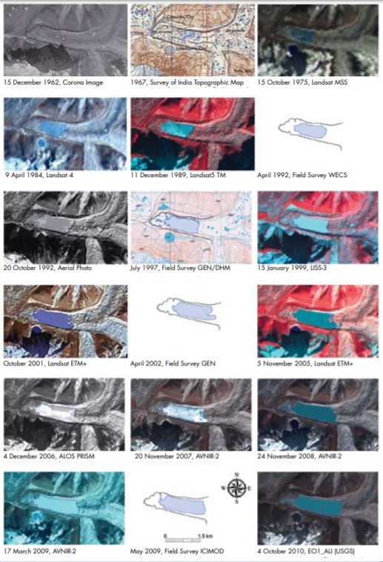
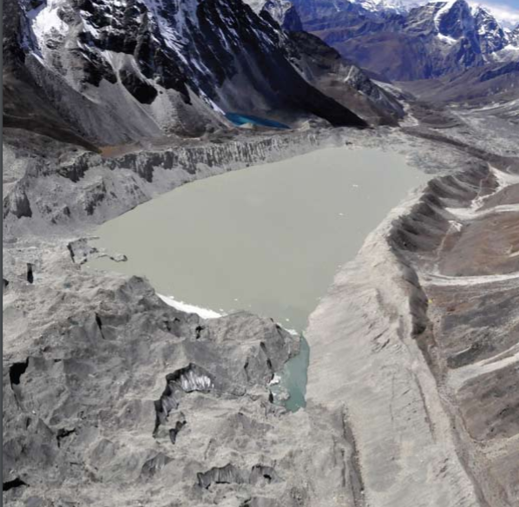

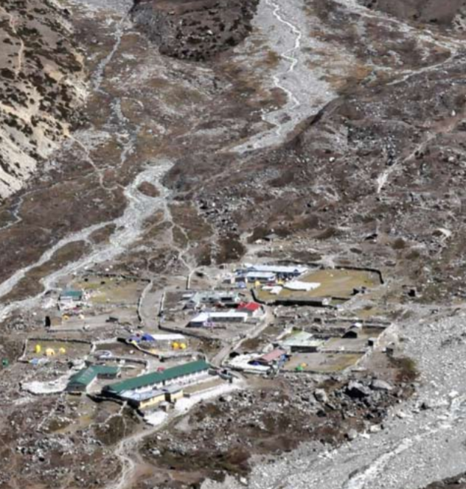
Inclusiveness: Space Application
Glacial Lakes and Glacial Lake Outburst Floods in Nepal
50 years of accumulated knowledge of earth systems, including atmosphere, land, oceans and ice coverage
CORONA, first space reconnaissance satellite collected over 800,000 images in 1960s, which were made public in 1995
Imja Tsho lake and downstream village, Nepal, October 2010
Credits: ICMIOD

Slide 11

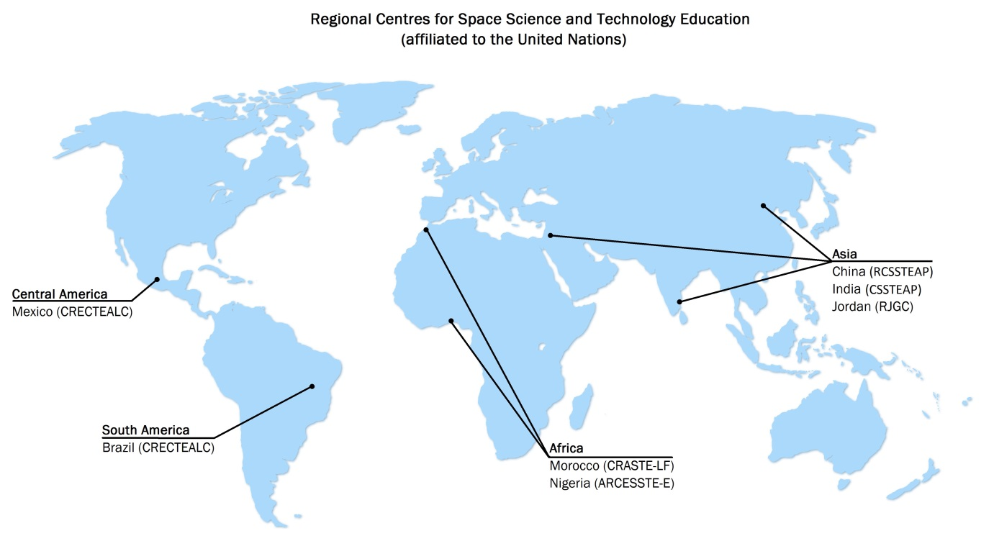

Regional Centres for Space Science and Technology Education (affiliated to the United Nations)
Post graduate diploma and master courses in
Remote Sensing and GIS
Satellite communication
Satellite navigation
Satellite meteorology
Space law
Short course on specific themes
Webinars on advanced topics
UNOOSA promotes inclusiveness and equality through quality education designed for developing countries.

Slide 12

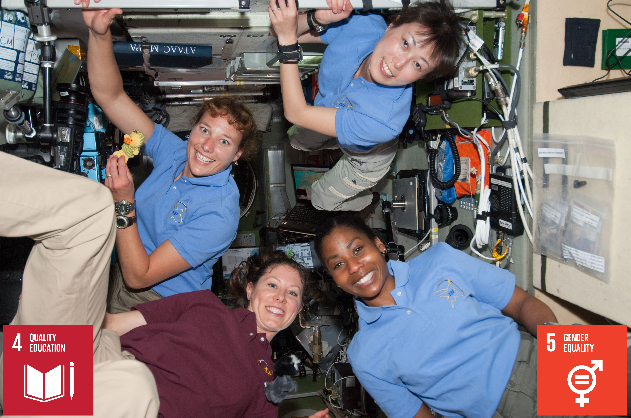
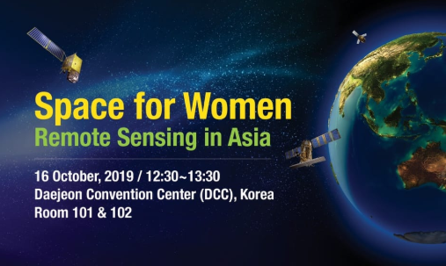
Making ‘Space for Women’ a Reality – Next Steps
Space for Women Platform
Central hub for global initiatives under the UN roof for exchange, communication and coordination
Space for Women Research
Research on various aspects of women in STEM and Aerospace for evidence based awareness raising
Space for Women Institutional Capacity Building Mission
Space for Women Forum
Team of experts to assess the institutional and enabling environment in a pilot country second half 2019
Space for Women Champions Network
Global Network of role models and mentors to promote careers in STEM and the Space Sector
Capacity building and awareness raising forum in 2019
UNOOSA’s Space for Women Project – Gender inclusiveness
Space4Women project helps empower women in space and STEM

Slide 13


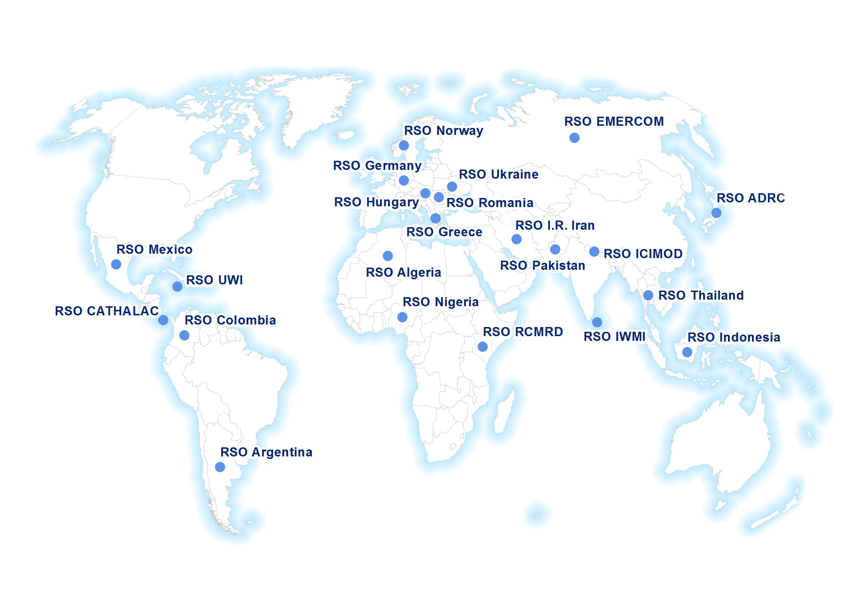

RSO USA
United Nations Platform for Space-based Information for Disaster Management and Emergency Response
www.un-spider.org
Mission: Ensure that all countries have access to and develop the capacity to use all types of space-based information to support the full disaster management cycle.
UN-SPIDER Regional Support Offices

Slide 14


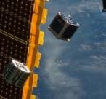
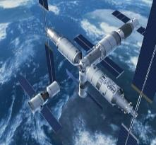
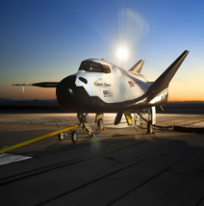
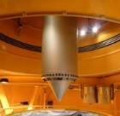
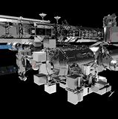
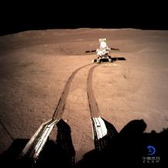
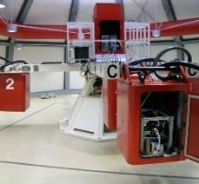
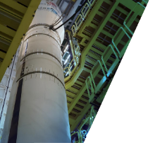
Research Institutes
Space Agencies
Private Sector
JAXA
CMSA
SNC
Airbus
ZARM
CNSA
ESA
Avio
Access to Space for All
Micro/hypergravity simulation
Access to Orbit
Access to space stations
Open space data
Training
KiboCUBE
UNNATI (UNispace Nanosatellite Assembly & Training by ISRO
Space Experiments on-board China Space Station
Drop Tower Experiment Series" (DropTES)
Interest for Dream Chaser® mission dedicated to the Sustainable Development Goals
Accessing Space with the ISS Bartolomeo Platform

Slide 15
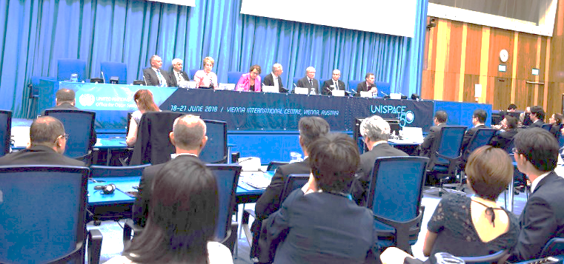


UNISPACE+50 reflected on more than 50 years of achievement in space exploration and use
June 2018
Efforts to promote and support Equality and inclusiveness, reaffirming that the benefits of outer space shall be accessible to all States irrespective of their level of economic, social, scientific or technical development and in accordance with international law, and promoting gender equality throughout all sectors.

Slide 16
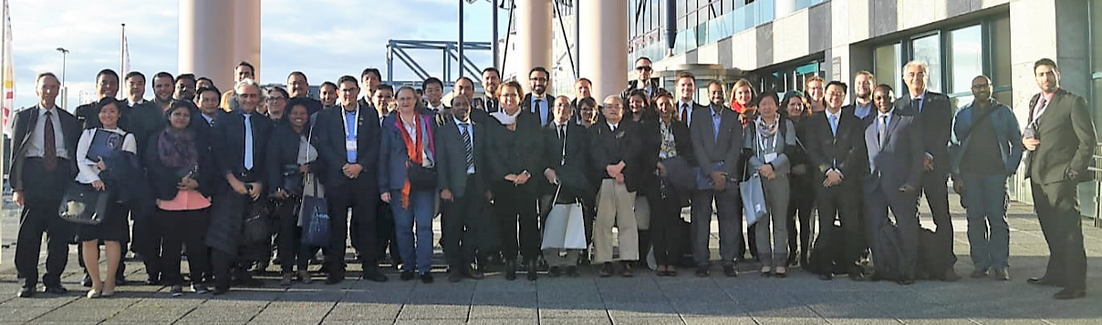
Keynote speeches
Plenary sessions
Space for Inclusiveness: Leaving no one behind
Mobilizing everyone: Innovative space applications for socio-economic development
Opportunities for space emerging countries and industries to join efforts on space science and technology
Space exploration for everyone
Developing collaborations for space applications
High Level Panel: Efforts of the space community to ensure no one is left behind
Interactive sessions
Poster sessions

Slide 17
shirish.ravan@un.org

