Slide 2
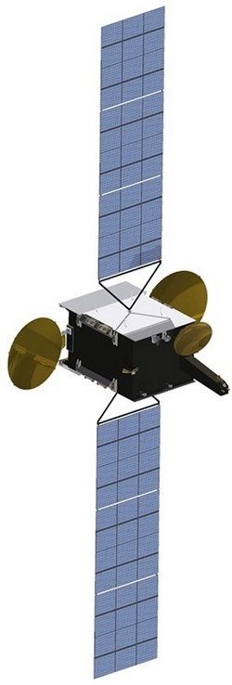
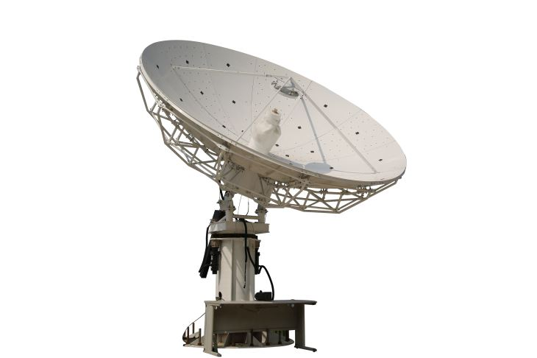
Telecommunications
Main evolutions
Historically the overwhelming majority of civil satellite orders have been for telecommunication satellites
Driven by satellite TV broadcast – commercial market
Early 2000’s: first satellite constellations projects - failure
Demand for internet access anywhere
First Public-Private Partnerships for satellite projects
New Space with new satellite constellation projects as cost of launching a kg into orbit decreased dramatically – still risky
Hybrid infrastructure that combines terrestrial and satcom systems
Will remain the main space application market in the years to come

Slide 3
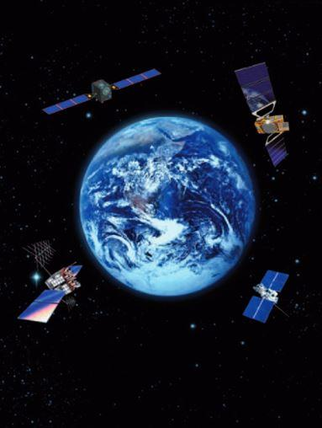
Navigation
Main evolutions
Government-owned constellations
User receivers are a commercial market (“Downstream” market)
Public-private partnership for Galileo failed
Offer of signals increased tremendously in recent years:
4 core constellations
+ regional systems
+ augmentation systems
Development of downstream applications

Slide 4
Earth Observation
Main evolutions
Historically institutional programmes
2010’s: smaller satellites technology and lower cost of launchers – commercial projects
Growth in downstream market: move from providing just data to value-added services (i.e. similar to telecom)
Massive capacity increase with more providers of services and price pressure
Terabytes of data per day, every day, that need to be further processed - use of Artificial Intelligence
Share of Earth Observation in space applications will rise in the years to come

Slide 5
Thank you!
Nathalie Ricard
Scientific Affairs Officer
Space Applications Section
United Nations Office for Outer Space Affairs
Vienna, Austria
nathalie.ricard@un.org | www.unoosa.org

