Slide 1
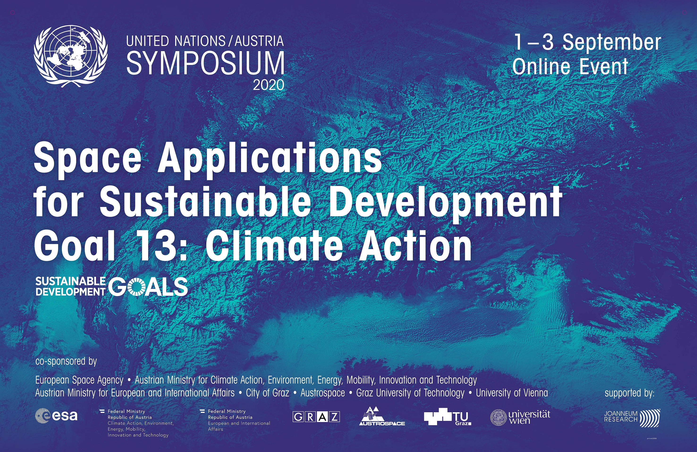

Slide 2
HOUSERULES
All presentations are already available for download on UNOOSA webpage https://www.unoosa.org/oosa/en/ourwork/psa/schedule/2020/2020Graz.html Please ask questions through the chat anytime: our Moderators will gather and forward questions to the Chairs and Speakers The WebEx link you received is valid for the 3 days

Slide 3
PROGRAMME AT A GLANCE
 | 1 September 2020 | 2 September 2020 | 3 September 2020
Morning | Introduction Welcome ceremony Keynote presentation Session 1: Climate Action | Session 2: Energy and natural resources Project pitch Keynote presentation | Keynote presentation Panel 2: International cooperation and best practices for Climate Action Conclusion
 | Break | Break
Afternoon | Project pitch Panel 1: General principles of international environmental law and space activities Project pitch | Session 3: Agriculture and forestry Project pitch Session 4: Urban planning and disaster management

Slide 4
TUESDAY, 1 SEPTEMBER 2020
10:00 CEST | Introduction
10:05 | Welcome ceremony
10:45 | Keynote presentation: Three decades of Earth observation for climate monitoring - what has been achieved, what challenges are next? (Josef Aschbacher, European Space Agency)
11:15 | Break
11:30 | Session 1: Climate Action
13:00 | Break
14:00 | Project pitch: Developing a dengue outbreak prediction model in a smart city platform (Ana Cristina Galhego Rosa, Dipteron)
14:05 | Panel 1: General principles of international environmental law and space activities
15:45 | Project pitch: Space technologies closing the loop for food systems on Earth (Lee Recht, Aleph Farms)
16:00 CEST | Adjourn

Slide 5
10:05 | WELCOME CEREMONY
Moderators: Otto Koudelka (Technical University Graz) and Irmgard Marboe (University of Vienna)
Gabriella Sellner | Federal Ministry European and International Affairs, Austria
Margit Mischkulnig | Federal Ministry Climate Action, Environment, Energy, Mobility, Innovation and Technology (BMK), Austria
Heinz Mayer | Joanneum Research, Austria
Hans-Martin Steiner | Austrospace
Stephan Mayer | Austrian Research Promotion Agency (FFG)
Siegfried Nagl (video message) | Mayor of the City of Graz
Luc St Pierre | United Nations Office for Outer Space Affairs

Slide 6
11:30 | SESSION 1: CLIMATE ACTION
Chair |  | Nathalie Ricard | United Nations Office for Outer Space Affairs
Chat Moderator |  | Luc St Pierre | United Nations Office for Outer Space Affairs
Space-based observation support for the Paris Agreement |  | Joanna Post | United Nations Framework Convention on Climate Change
User-centric satellite solutions for effective climate actions |  | Annalisa Donati | EURISY
Free data policy and environmental regulations: urgency for climate change action |  | Marcia Alvarenga dos Santos | National Institute for Space Research (INPE), Brazil
Climate change in Indonesia's new developmentalism |  | Yunita Permatasari | National Institute of Aeronautics and Space LAPAN, Indonesia

Slide 7
14:05 | PANEL 1: GENERAL PRINCIPLES OF INTERNATIONAL ENVIRONMENTAL LAW AND SPACE ACTIVITIES
Chair | Yvonne Karimi-Schmidt | University of Graz, Austria
Chat moderators | Irmgard Marboe and Cordula Steinkogler | University of Vienna, Austria
Panelists | Niklas Hedman | United Nations Office for Outer Space Affairs
 | Sergio Marchisio | Sapienza University of Rome, Italy and ECSL
 | Eva Schulev-Steindl | Karl-Franzens-Universität Graz, Austria
 | Jonathan Lim | Jus Ad Astra, Australia

Slide 8
WEDNESDAY, 2 SEPTEMBER 2020
10:00 CEST | Welcome
10:05 | Session 2: Energy and natural resources
11:15 | Project pitch: (1) Using space technology to combat the role of microplastics in climate change (Funmilola Adebisi Oluwafemi, NASRDA) (2) Assessing geo-hazard vulnerability of urban areas using satellite data (Pablo Ezquerro Martín, Spanish Geological Survey)
11:40 | Keynote presentation: She-Space international: facilitating access to academic space education and state of the art technologies (Shimrit Maman, EPIF, Ben-Gurion University of Negev)
12:10 | Break
13:00 | Session 3: Agriculture and forestry
14:20 | Project pitch: Space-based assessment of climate change impacts: increasing urban resilience in African cities (Elisabeth Bergler, Regional Academy of the United Nations / Alpen Adria University)
14:25 | Break
14:40 | Session 4: Urban planning and disaster management
16:15 CEST | Adjourn

Slide 9
10:05 | SESSION 2: ENERGY AND NATURAL RESOURCES
Chair |  | Nina Kickinger | United Nations Office for Outer Space Affairs - Space4Water Portal
Chat Moderator |  | Nathalie Ricard | United Nations Office for Outer Space Affairs
The role of microsatellites in reducing industrial methane emissions |  | Adina Gillespie | GHGSat, Canada
Space assets for mapping of mineral resources on the seabed |  | João Carvalho | ISQ, Portugal
Using satellite data to empower communities in low-infrastructure regions |  | Celia Davies | Omanos Analytics, UK

Slide 10
13:00 | SESSION 3: AGRICULTURE AND FORESTRY
Chair |  | Shirishkumar Ravan | United Nations Office for Outer Space Affairs
Chat Moderator |  | Otto Koudelka | Technical University of Graz, Austria
Earth Observation for agriculture |  | Clement Atzberger | BOKU, Austria
Converging space technology and local community to combat desertification |  | Kavya Kamepalli | International Institute of Aerospace Engineering and Management, Jain University, India
Farm sustainability tool for nutrients |  | Luigi Scatteia | PwC, France
Monitoring of forest health |  | Matthias Schardt | Joanneum Research, Austria

Slide 11
14:40 | SESSION 4: URBAN PLANNING AND DISASTER MANAGEMENT
Chair |  | Coen Bussink | United Nations Office for Outer Space Affairs - United Nations Platform for Space-based Information for Disaster management and Emergency Response
Chat Moderator |  | Luc St Pierre | United Nations Office for Outer Space Affairs
Disaster risk management 2.0: why linking new data sources makes a difference |  | Markus Enenkel | Perigee, Austria / Harvard Humanitarian Initiative
Assessment of coastal erosion vulnerability using integrated remote sensing and GIS methods |  | Komali Kantamaneni | Solent University, UK
Sentinel-1 for fully-automatic monitoring of floods |  | Bernhard Bauer-Marschallinger | Vienna University of Technology (TU Wien), Austria
Satellite data for flood prevention in São Paulo |  | Francisco Campos da Costa | Catholic University of Santos, Brazil

Slide 12
THURSDAY, 3 SEPTEMBER 2020
10:00 CEST | Welcome
10:05 | Keynote presentation: Space & International cooperation as critical tools for a better future (Simonetta di Pippo, United Nations Office for Outer Space Affairs)
10:35 | Panel 2: International cooperation and best practices for Climate Action
11:45 | Conclusion
12:00 CEST | Close

Slide 13
10:35 | PANEL 2: INTERNATIONAL COOPERATION AND BEST PRACTICES FOR CLIMATE ACTION
Chair | Markus Woltran | United Nations Office for Outer Space Affairs
Chat moderators | Irmgard Marboe and Cordula Steinkogler | University of Vienna, Austria
Panelists | Christoph Aubrecht | World Bank / European Space Agency
 | Frederic Bretar | French Space Agency (CNES)
 | Emmanuel Pajot | European Association of Remote Sensing Companies (EARSC)
 | Eri Nakajima | Ministry of the Environment, Japan
 | Lori Garver | Earthrise, USA

Slide 14
CONCLUSIONS
Nathalie Ricard and Luc St Pierre (United Nations Office for Outer Space Affairs); Otto Koudelka (Technical University Graz) and Irmgard Marboe (University of Vienna)
308 attendees from 77 countries attended this online event Thank you to all Speakers and to all who asked questions! All presentations are available for download on UNOOSA webpage https://www.unoosa.org/oosa/en/ourwork/psa/schedule/2020/2020Graz.html The event’s report will be available on UNOOSA webpage

