Slide 1
User-centric satellites solutions for effective climate action
Annalisa Donati
Coordinator of Activities
Eurisy
UN/Austria Symposium - Session 1 01 September 2020

Slide 2
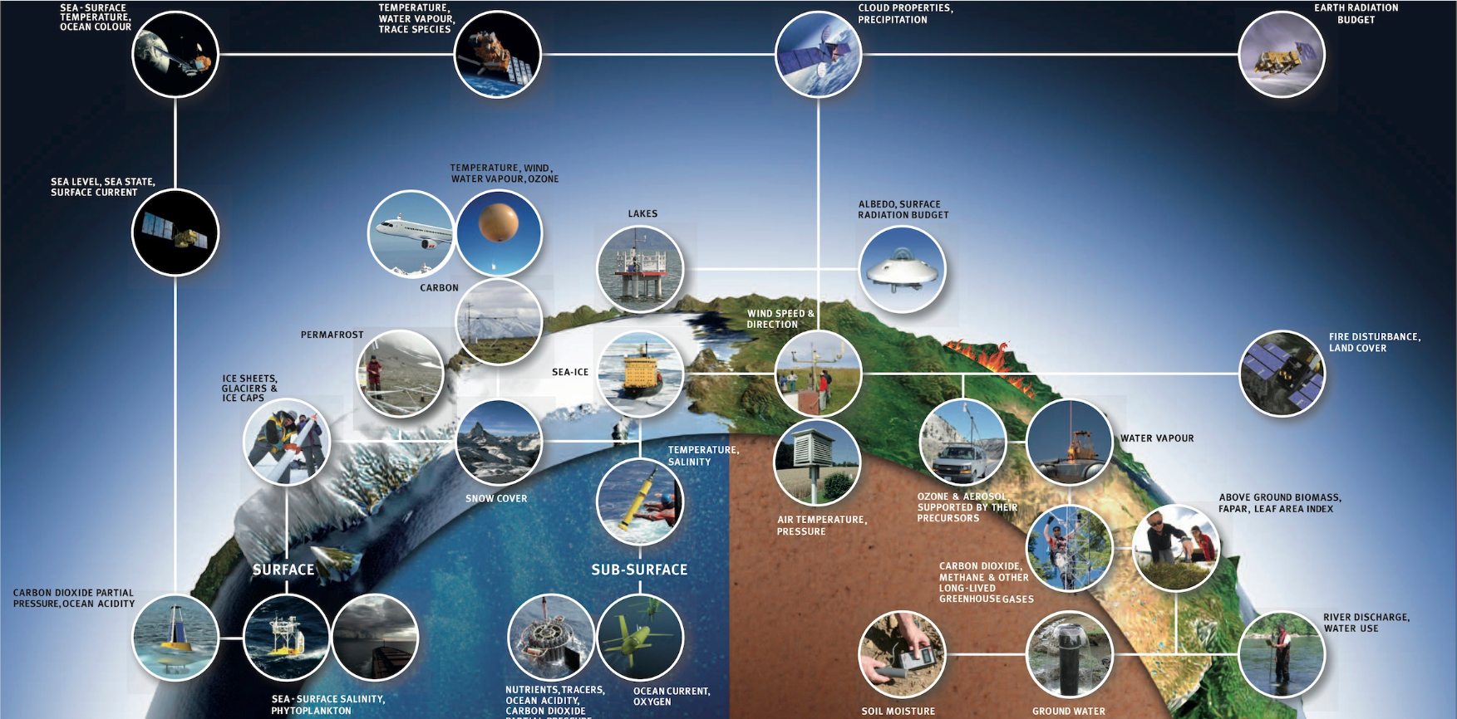
How space is contributing?

Slide 4
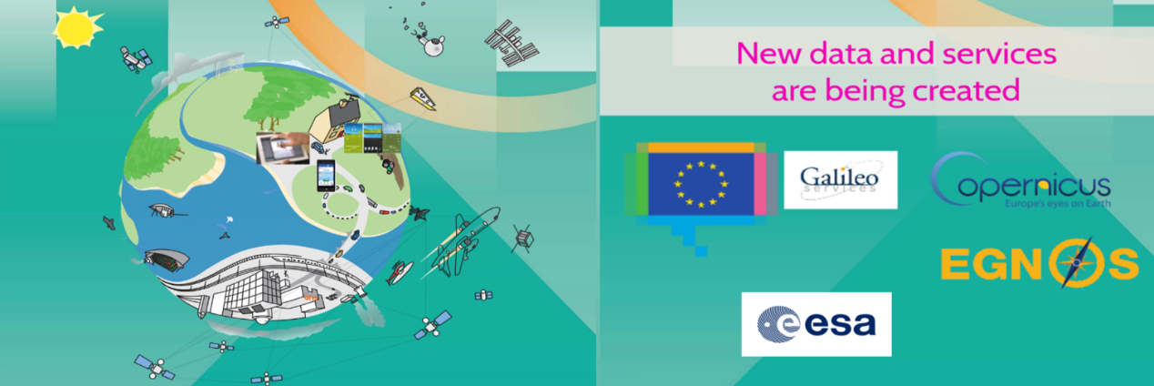

Slide 5
Recent activities
Historic Environment Scotland: Using satellite data to protect heritage from climate change
Kermap: an innovative way to monitor green areas in our cities
Kermap – Urban climate of Rennes
ARPA Emilia-Romagna: Satellite images to forecast seasonal irrigation needs
iColt

Slide 6
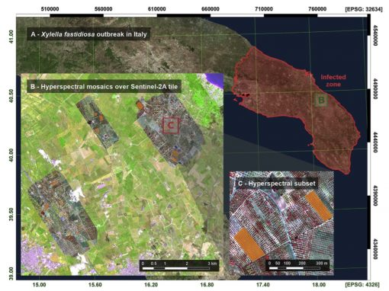
Recent activities
Policy Brief: Fostering the use of satellite Remote Sensing to support Plant Health surveillance activities

Slide 7
e-shape
48 months | 54 partners | EU contribution 15M €
Foster the development of valuable Earth Observation services with and for the users

Slide 8
Global Carbon and Greenhouse Gas Emissions
The solution:
a powerful Big Data product merging several publicly available Essential Ocean Variable (EOV) Inorganic Carbon data products and data from various ocean observing systems (Argo, OceanSites, GO-SHIP, SOCONET) that will significantly reduce the uncertainty in ocean carbon sink estimates;
a semi-operational system providing NRT (year-1) land carbon fluxes at high spatial and temporal resolution based on integrating ecosystem measurements, remote sensing, and machine learning.
The partners:
ICOS ERIC with MPI-BGC, Germany, University of Bergen, Norway, University of Exeter, UK, and University of East Anglia, UK as linked third parties;
UHEL, FMI, CMCC
Key Users:

Slide 9
Urban resilience to extreme weather - climate service
The solution:
A climate service based on post-processing models will be used for seasonal and shorter-term forecasts combined with in-situ observations to assess the risk of urban hazards and to support the reduction of risks in cities and their surroundings by appropriate adaptation strategies
The partners:
DWD, German Meteorological Service
FMI, Finnish Meteorological Institute
ZAMG, Central Institution for Meteorology and Geodynamics Austria
Cities and Municipalities of:
Key Users:
Notes:
Approved by the pilot

Slide 10
Forestry conditions - climate service
The solution:
a service to forecast frozen soil depth and soil moisture from Copernicus C3S seasonal predictions to estimate carbon emission impacts of harvesting with several different management options gaining efficiency and limiting potential production shortfalls.
The partners:
FMI, Finnish Meteorological Institute
UHEL, Univeristy of Helsinki
Forestry operators, forest owners, timber buyers, consultants
Key Users:
HarvesterSeasons.com is online

Slide 11
Hydropower in snow reservoir – climate service
The solution:
a high resolution high quality product determining snow conditions to improve timeliness and information content for hydropower optimization using Sentinel-1/-2/-3 data
The key diagnostics are reservoir inflow and snow reservoir energy potential, which together with other factors is a measure of stored hydropower potential.
The partner:
FMI, Finnish Meteorological Institute
Key Users:
Hydropower Companies

Slide 12
Seasonal preparedness
The solution:
A user oriented climate service providing newly developed tailored sub-seasonal and seasonal forecasts on onset and offset of winter tires season and other transportation safety related indices in Finland, and bioclimatic indices over Greece building on Copernicus services
The partners:
FMI, Finnish Meteorological Institute
AoA, Academy of Athens
Key Users:

Slide 13
Thank you!
Follow us:
https://www.facebook.com/eurisy1
@Eurisy1
linkedin.com/company/eurisy
www.eurisy.org

