Slide 1
Disasters, climate change and UN-SPIDER
Space Based Information for Disaster Management and Emergency Response
Coen Bussink
August 2020

Slide 2
UN-SPIDER
Ensure that all countries have access to and develop the capacity to use all types of space-based information to support the full disaster management cycle

Slide 3
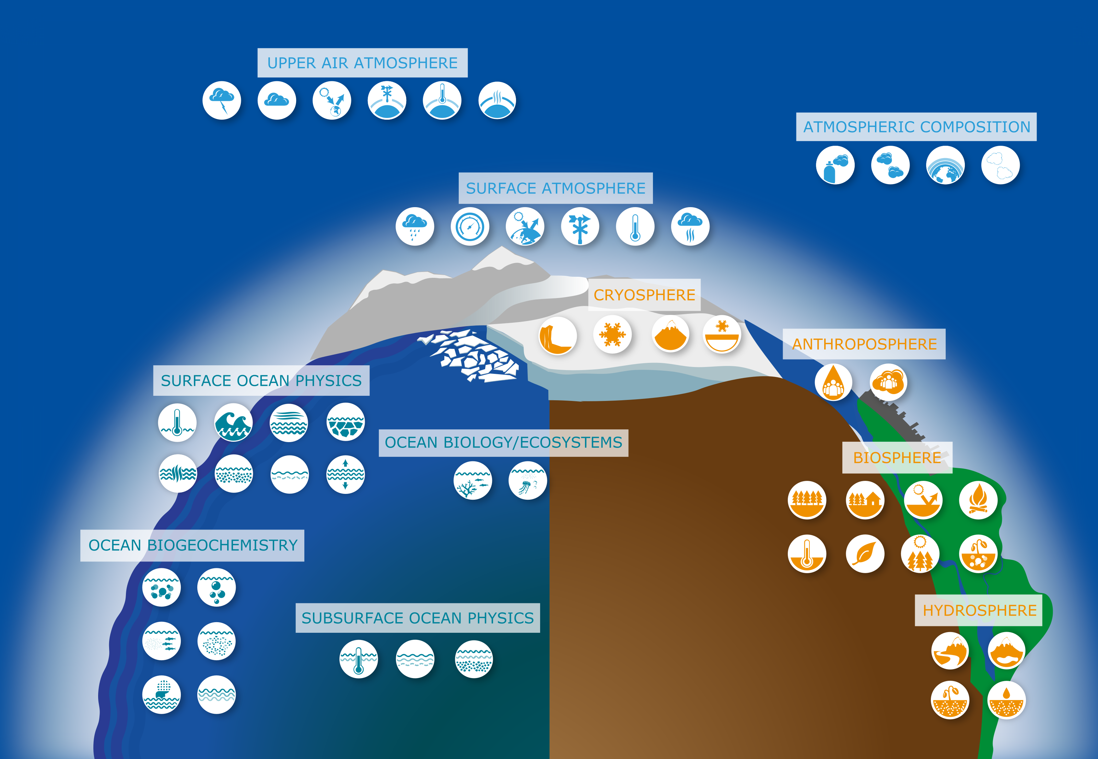
Monitoring climate from space
Monitoring of essential climate variables need space satellites
Satellites provide the global coverage needed
Space Climate Observatory (SCO) established in 2017 to pool and share climate data collected from space
Image credit: GCOS
Notes:
Space for climate & Space Climate Obervatory (SCO)
There are 54 essential climate variables which are physical, chemical or biological variable or a group of linked variables that critically contributes to the characterization of Earth’ s climate as defined by the Global Climate Observing System (GCOS) a co-sponsored programme by WMP, UNESCO, UNEP and the International Science Council.
ECV datasets provide the empirical evidence needed to understand and predict the evolution of climate, to guide mitigation and adaptation measures, to assess risks and enable attribution of climate events to underlying causes, and to underpin climate services
26 of these variables can only be measured from space
Furthermore, 65 of the 169 SDG targets (almost 40%) are reliant on geolocation and Earth observation
Therefore, only satellites can provide the global coverage needed for climate action
Following the Paris Agreement in 2015, the Space Climate Observatory (SCO) was established in 2017 to pool and share climate data collected from space to help territories and their populations adapt locally. This international mission is one in which satellites will prove vital.
https://corporate.cnes.fr/l-espace-en-tete/challenges-climate.html
https://cnes.fr/fr/media/une-charte-face-au-changement-climatique
Today, more than ever before, there is a deeper understanding of the factors which impact the likelihood of disasters, the drivers of climate change, and the impacts these two interlinked phenomena might have on the path to bring peace and prosperity to communities worldwide.
Climate change, while traditionally natural to the Earth’s cycles, is now accelerated by human activities and its impacts are felt in all corners of our planet. Only through collective action, involving all stakeholders and people, we can find a solution. It has been clear since the very beginning that the Sustainable Development Goal 13 is not a standalone issue, as the impacts of rapidly changing climate spill over to all other goals.
Probabilistic Event Attribution
It is today already possible to say how much more likely an extreme weather event is as a result of climate change. The emerging field of attribution science, called Probabilistic Event Attribution (PEA), is improving rapidly. It allows scientists to perform quantitative assessments and say with a level of certainty how much climate change increased the likelihood of an event. Studies have shown that climate change is indeed worsening the impacts of natural disasters, including hurricanes, harmful algal outbreaks, megafires, droughts, and floods. Simply put, changes in the global climate exacerbate climate hazards and amplify the risk of extreme weather disasters. Increase

Slide 4
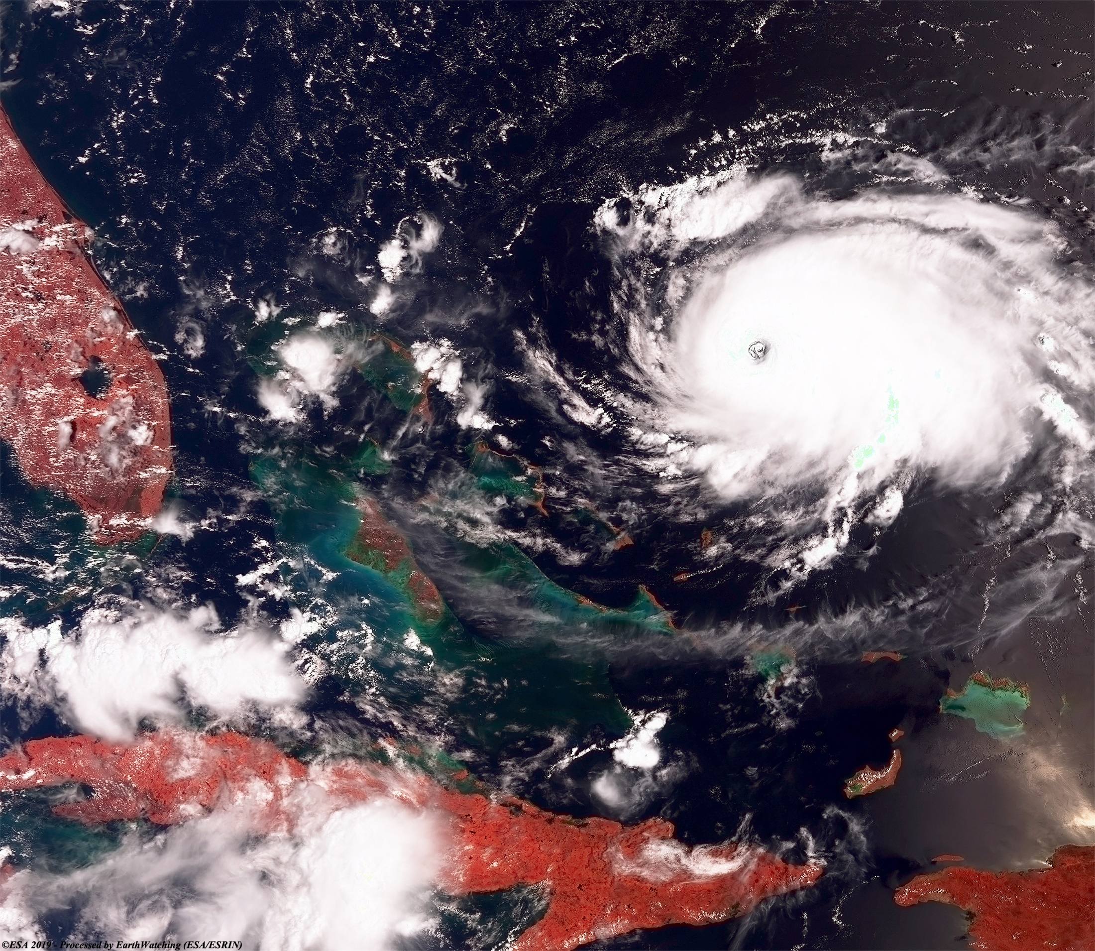
Climate Change Exacerbates Disasters
Facts
In the past 25 years there has been an increase in the frequency and severity of disasters
In the last two decades, disasters
Cost 1.3 million lost lives
Affected more than half of the world’s population
Caused damages in trillions of dollars
Earth Applications
Space-based technologies can contribute to all phases of the disaster management cycle.
Satellites are not vulnerable to destruction by disaster
Space assets provide reliable and rapid communication, observation and positioning tools
Image credit: ESA Hurricane Dorian, 2019
Notes:
of air and water temperatures leads to rising sea levels, supercharged storms and higher wind speeds, more intense and prolonged droughts, heavier precipitation and flooding.

Slide 5
UN-SPIDER
Knowledge Portal
The UN-SPIDER Knowledge Portal is a web-based tool for information, communication and process support
Fostering Cooperation
UN-SPIDER fosters alliances and creates forums where both space and disaster management communities can meet
Capacity Building
UN-SPIDER facilitates capacity building and institutional strengthening, including the development of curricula and an e-learning platform (e-SPIDER)
Technical Advisory Support
UN-SPIDER provides support to countries in assessing national capacity and in evaluating disaster and risk reduction activities, policies and plans
and many more…

Slide 6
coen.bussink@un.org
http://www.un-spider.org/
https://www.unoosa.org/oosa/en/ourwork/psa/emnrm/climatechange.html
https://www.spaceclimateobservatory.org/about-sco

