Slide 1
United Nations/Austria Symposium:
"Space Applications for Sustainable Development Goal 13: Climate Action"
1-3 September 2020
Session 3: Agriculture and forestry
Shirish Ravan
United Nations Office for Outer Space Affairs
shirish.ravan@un.org

Slide 2
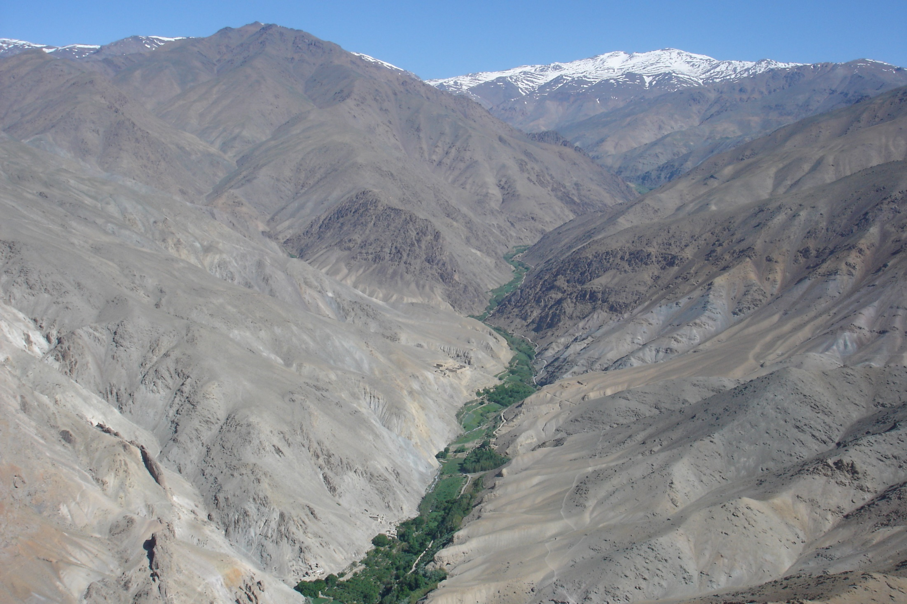
How climate change impacts
Agriculture
Forests
+ Carbon sequestration
- Greenhouse gases
+ Carbon sequestration &
other ecosystem functions
Changing rainfall patterns Rising temperatures Extreme weather events
Droughts Flooding Insect outbreaks Invasive species Wildfires

Slide 3
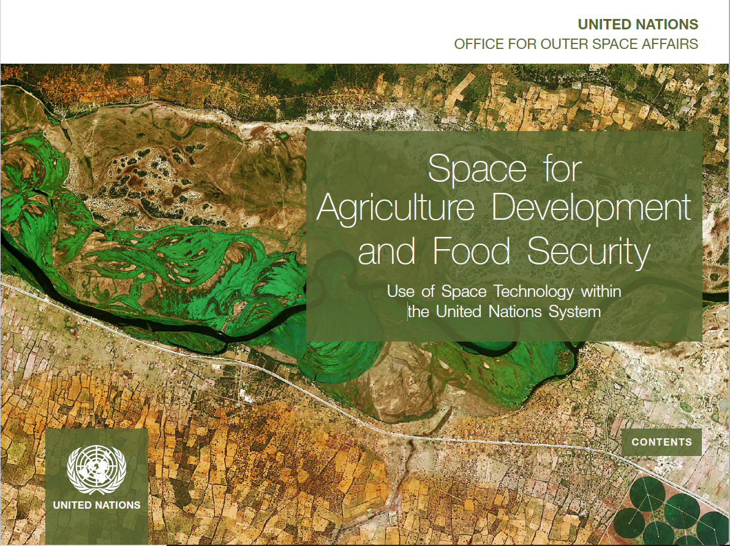
UNOOSA@Agriculture
The United Nations/Romania International Conference on Space Solutions for Sustainable Agriculture and Precision Farming
Cluj, Romania, 6-10 May 2019
Key Recommendations
International cooperation needed for
technological advancement
capacity-building
knowledge exchange and
policy development
Long-term study on the impact of climate change on agriculture and
Development of early warning systems to monitor risk to agriculture
http://www.unoosa.org/oosa/en/benefits-of-space/agriculture.html
Notes:
The space solutions compendium is a list of space-related solutions that each country can apply in accordance with its space strategy
The compendium is a key tool for supporting the 2030 Agenda for Sustainable Development, linking space solutions with SDG goals and targets.
Through the compendium, UNOOSA would act as a focal point, pairing solutions provided by developed and developing countries, monitoring the effectiveness of those solutions and identifying user needs to deliver more targeted capacity-building

Slide 4
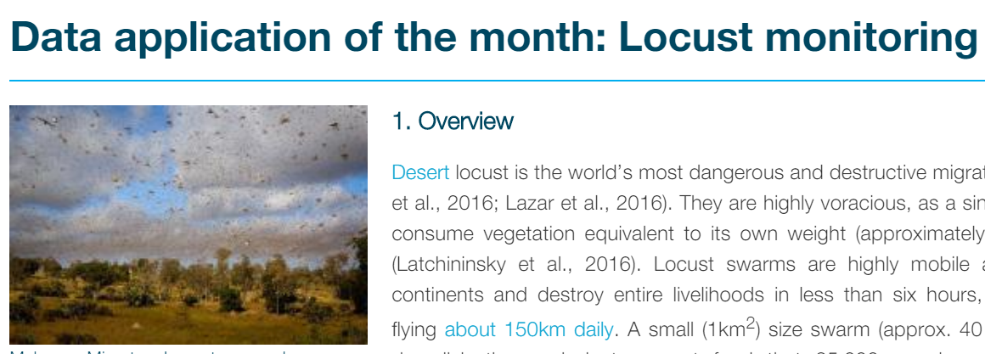
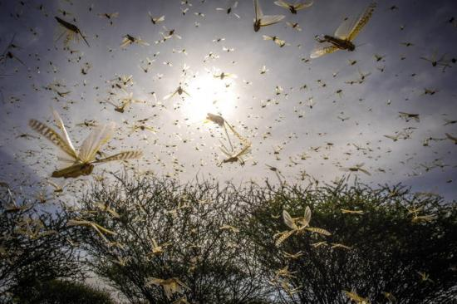
UNOOSA/UN-SPIDER and the International Water Management Institute (IWMI) webinar “Space-based inputs for locust early warning and preparedness”
UNOOSA@Agriculture
UN-SPIDER Knowledge Portal
www.un-spider.org

Slide 5
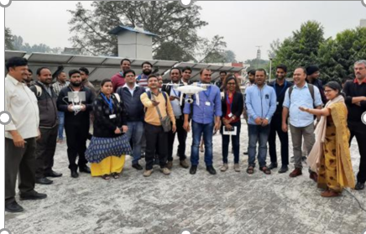
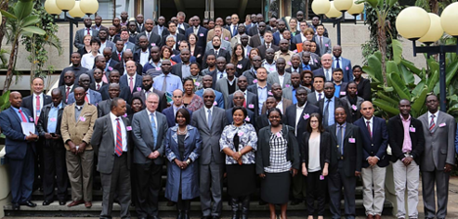
UNOOSA@Forestry/Ecosystems
United Nations/Kenya Conference on Space Technology and Applications for Wildlife Management and Protecting Biodiversity
27-30 June 2016, Nairobi, Kenya
India-International Training Course “Space-based Information Systems for Ecosystem-based Disaster Risk Reduction (Eco-DRR)”, November 2019, Roorkee, India
Publication: Geospatial Tools and Natural Solutions (GEOS-NAT) for Urban Risk Analysis: Earth observation for Blue-Green Infrastructure Planning

