Slide 1
UNOOSA Space Law for New Space Actors:
For Governmental Officials and Beyond
Rosanna Hoffmann
United Nations
Office for Outer Space Affairs

Slide 2
National Space Law
Why does a country need national space law and policy?
What are the elements to be considered in national space law?
How can UNOOSA support States through the Space Law for New Space Actors Project
Where can one find examples?
Notes:
IF

Slide 3
Why national space law and policy?
Compliance with obligations under International (Space) Law
Prevent and avoid harmful consequences
Consistency & predictability
Practical regulatory system
Space economy, society, accessibility, diplomacy & national security
Regional and international cooperation
“NSL as the continuation, concretion and completion of international space law”
Notes:
IF

Slide 4
International Space Law:
United Nations Instruments
► Outer Space Treaty, 1967 (112 Ratification / 23 Signatures)
► Rescue Agreement, 1968 (99/23)
► Liability Convention, 1972 (98/19)
► Registration Convention, 1975 (72/3)
► Moon Agreement, 1979 (18/4)
► Declaration of Legal Principles (1963)
► Broadcasting Principles (1982)
► Remote Sensing Principles (1986)
► Nuclear Power Sources Principles (1992)
► Benefits Declaration (1996)

Slide 5
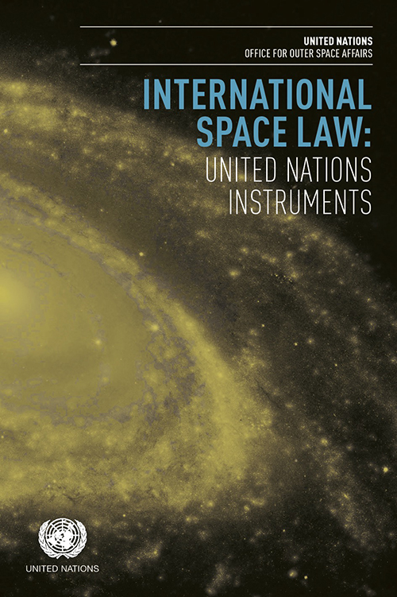
Other Instruments
Application of the concept of the “launching State” (2004)
Recommendations on registration of space objects (2007)
Recommendations on national legislation (2013)
Space Debris Mitigation Guidelines (2007)
Safety Framework for Nuclear Power Source (2009)
21 Long-term Sustainability Guidelines (2019)
To download the latest treaty booklet please visit our webpage!!
Available in all UN official languages.
https://www.unoosa.org/oosa/en/ourwork/spacelaw/treaties.html

Slide 6
Fiftieth Anniversary of the Outer Space Treaty
Declaration on the fiftieth anniversary of the Treaty on Principles Governing the Activities of States in the Exploration and Use of Outer Space, including the Moon and Other Celestial Bodies
(A/RES/72/78, 2017)
Urges States to become a party to the Outer Space Treaty
Emphasizes the benefits arising from adherence to the Treaty and that being party to the Treaty would enhance the ability of States to become part of international cooperation efforts in the exploration and use of outer space for peaceful purposes
Reiterates the role of the Treaty as the cornerstone of the international legal regime governing outer space activities and that the Treaty manifests the fundamental principles of international space law

Slide 7
Key elements to be considered in a
national space law
“Report of the Working Group on National Legislation Relevant to the Peaceful Exploration and Use of Outer Space on the work conducted under its multi-year workplan” of 3 April 2012 (A/AC.105/C.2/101):
Scope of application
Authorization and licensing of activities of non-governmental entities
Continuing supervision of activities of non-governmental entities
Registration
Liability and insurance
Safety
Transfer of ownership

Slide 8
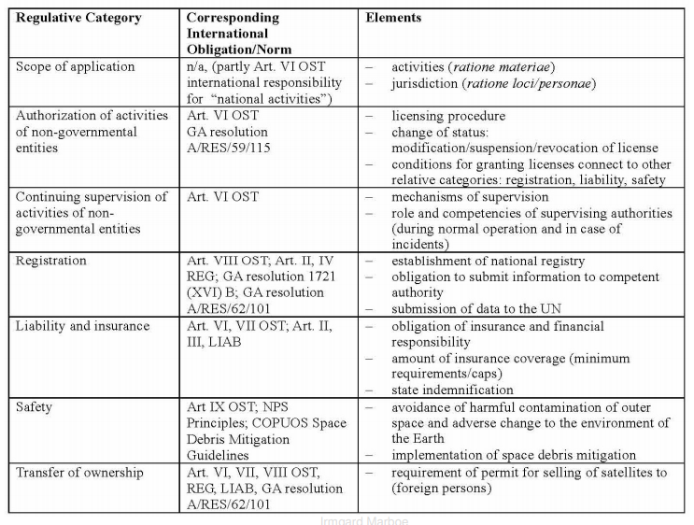
Annex of A/AC.105/C.2/101: National space legislation: regulative categories – set of elements for consideration by States in enacting national space legislation

Slide 9
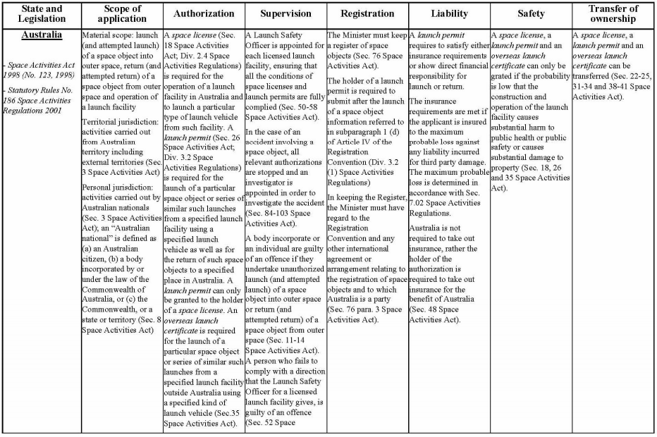

Slide 10
Where can I find examples?
Schematic Overview of National Regulatory Frameworks for Space Activities
Summary of the schematic overview of national space legislation
Table
April 2013: A/AC.105/C.2/2013/CRP.7 April 2014: A/AC.105/C.2/2014/CRP.5 April 2022:A/AC.105/C.2/2022/CRP.9
UNOOSA National Space Law collection
Asking States to share their national space law to be uploaded/linked to UNOOSA’s National Space Law Collection
https://www.unoosa.org/oosa/en/ourwork/spacelaw/nationalspacelaw/index.html

Slide 11
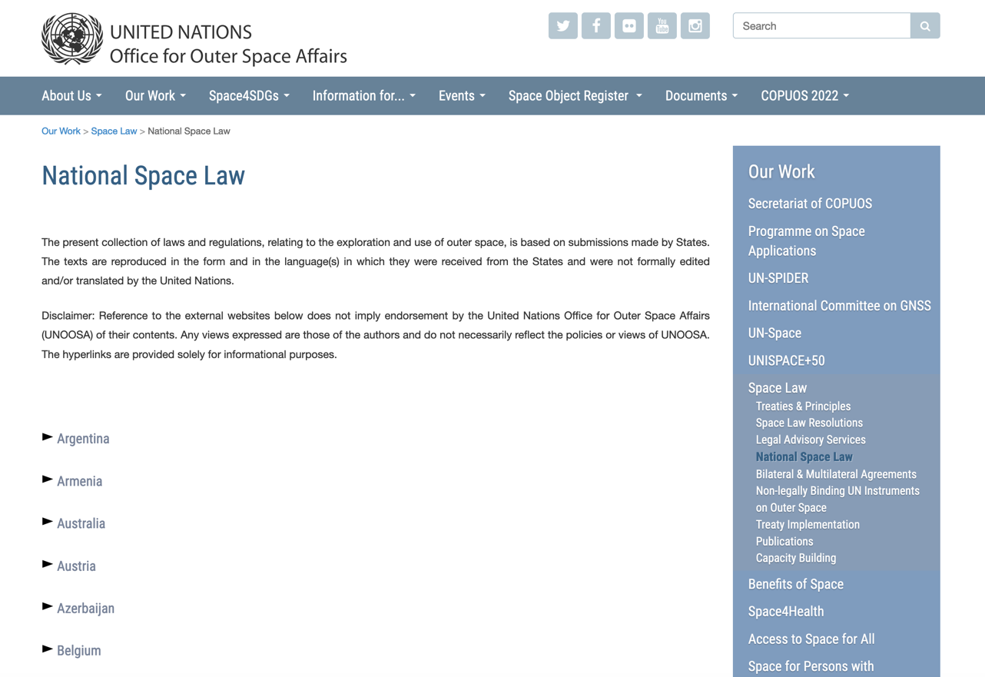

Slide 12
Space Law for New Space Actors Project Objectives
Dedicated advisory services to assist emerging space faring nations on national space legislation and national space policy
The project aims to (in collaboration with the requesting States):
Identify needs and deliver tailored advisory services
Raise global awareness levels of the fundamental principles of international space law
Support the universalization, adherence and implementation of the key components of normative framework
Notes:
IF

Slide 13
Legal Advisory Service
A Four Stage Method (12 months)
Stage 1) Development and research phase
Information gathering, baseline analysis & questionnaire
Stage 2) Tailor-made course development
Material development tailored to national needs; identification of experts to share knowledge & e-learning course
Stage 3) Technical Advisory Mission (event)
Deliver (on-site) legal advisory training sessions (3 days)
with case study/simulation
Stage 4) Follow-up and evaluation
Follow up and impact evaluation

Slide 14
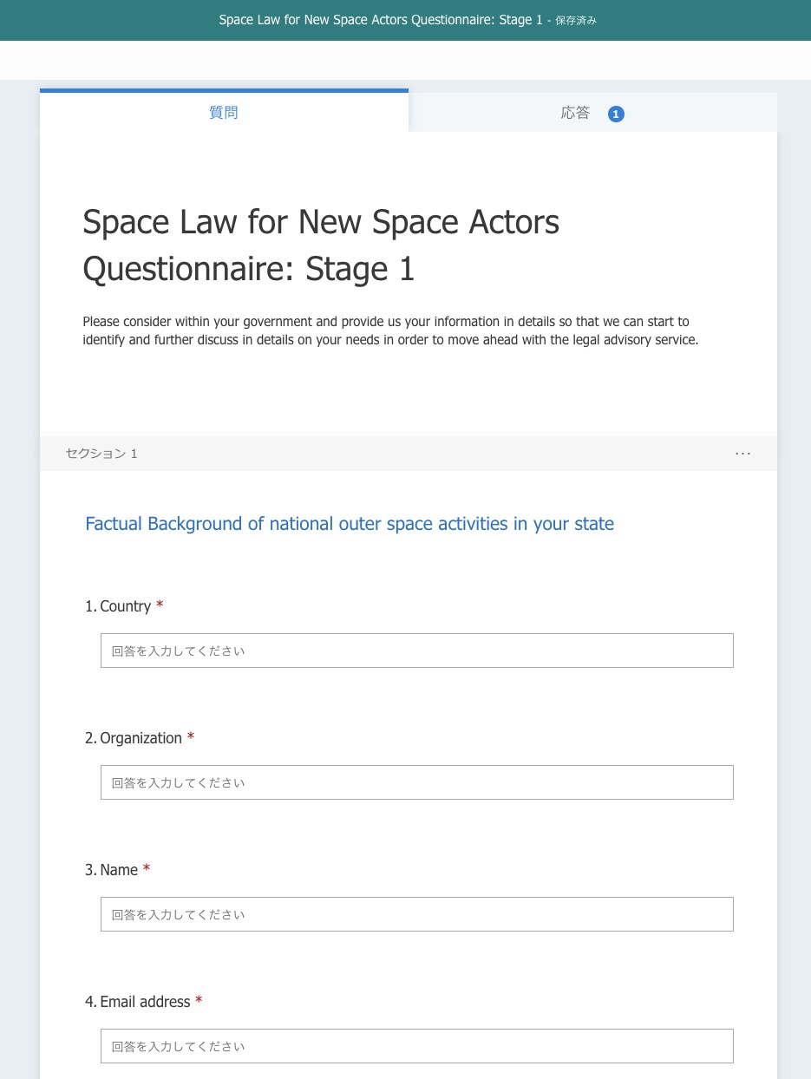
Questionnaire
Stage 1
Questionnaires include the following:
Factual background of national space activities in your country
Involved national authority
Existing framework related to space activities
Scope and the contents of future space policy/law and time frame
For a tailor-made programme including all the needs of the requesting country
Notes:
IF

Slide 15
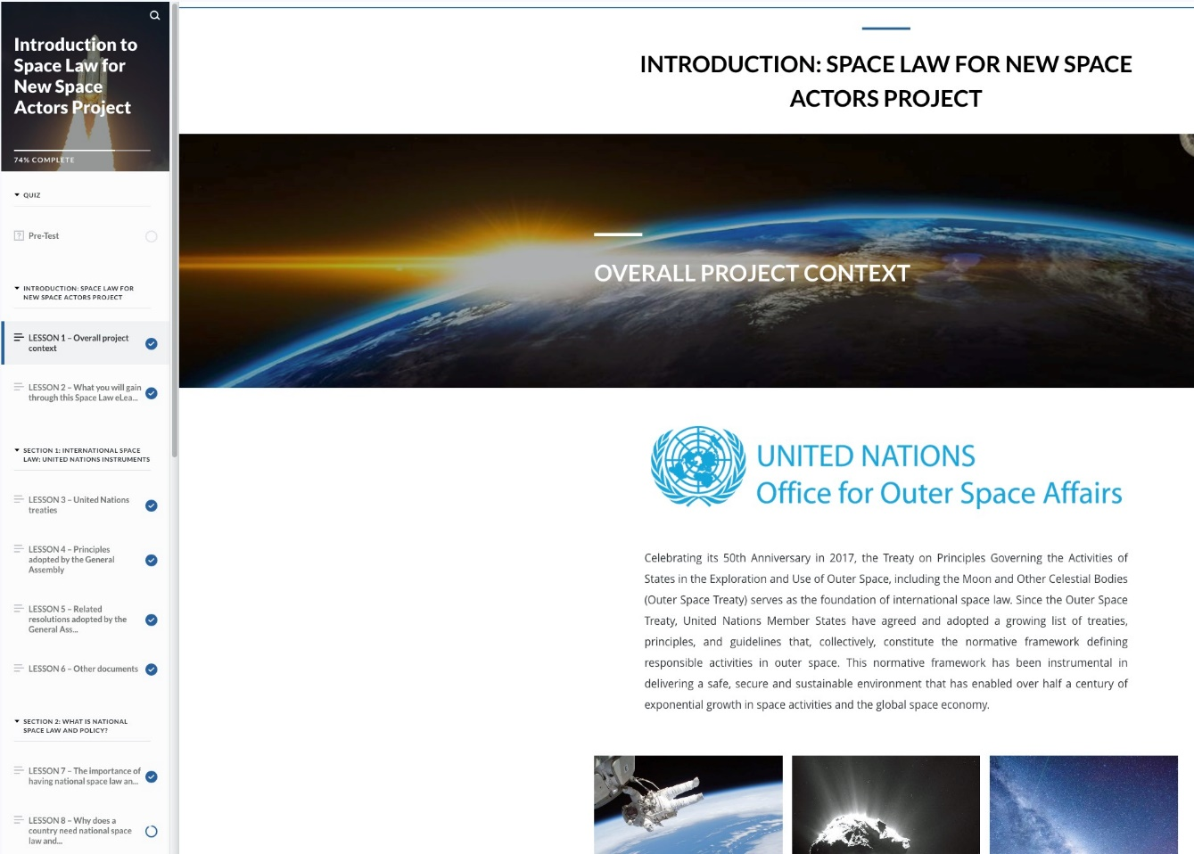
E-learning Course
Module 1:
National Space Law and Policy
Module 2:
International Space Law: United Nations Instruments
Module 3:
The 7 Key Elements of National Space Law
Module 4:
Guidance on Space Object Registration and Frequency Management for Small and Very Small Satellites
Spanish and French versions available!
A Certificate of Completion will be issued.

Slide 16
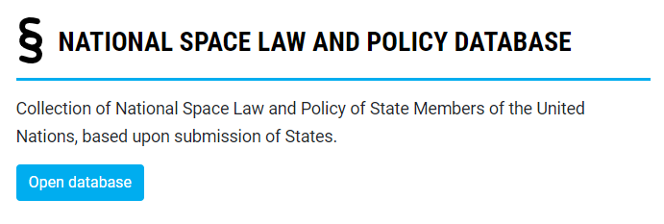
A collection of international and national instruments on space activities developed by UNOOSA
The objective of the platform is to
raise global awareness about and adherence to the five UN Space Treaties and additional non-binding instruments relevant to international space law
share best practices
foster the development of national legislation and policy related to space activities
https://astro.unoosa.org/astro

Slide 17
Technical Advisory Missions Delivered in 2022
Target Beneficiaries |  | Location | Language | Date
Chile | National authorities | Hybrid | Spanish | 13-16 Oct 2020
Regional | African countries | Online | English | 7 Dec 2020
Series of 16 Lectures | Global | Online | English | Oct 2021-Mar2022
Chile | National Authorities and Latin American Countries | Hybrid | Spanish | 19-21 Oct 2021
Rwanda National | National authorities | Online | English | 18-19 Jan 2022
Regional | Asia and the Pacific | Online | English | 24-26 Jan 2022
Chile | National Authorities and Latin American Countries | Hybrid | Spanish/English | 6-8 April 2022
The Philippines | National authorities | In person | English | 18-20 October 2022
Malaysia | National authorities | In person | English | 21-23 November 2022
Regional | African countries | In person | English/ French | 6-8 December 2022
Thailand | National authorities | Online | English | 15-16 December 2022

Slide 18
Technical Advisory Missions Planned in 2023
Target Beneficiaries |  | Location | Language | Date
Kenya | National authorities | In person | English | 18-20 April 2023
Regional | APSCO Member States | In Person | English | 12-15 June 2023
Morocco | National authorities | In Person | English/French | September 2023 (tbc)
Chile | National authorities | In Person | English/Spanish | October 2023
Costa Rica | National authorities | In Person | English/Spanish | October 2023 (tbc)
Regional | Asia and the Pacific | In Person | English | January 2024

Slide 19
Kyutech - Series of 16 Lectures
Students from over 20 countries (70% from emerging space-faring nations)
Lectures on space law delivered by UNOOSA staff
Country reports:
Students’ reports on the state of space activities in their home countries
Valuable information on non-COPUOS MS (Bhutan, Botswana, Cambodia, Honduras, Laos, Malawi, Nepal, Trinidad, Uganda, Zimbabwe)
Scenario-based exercise:
Students solving fictional problem touching on elements of international space law
UNOOSA-Kyutech collaboration allowed:
Students to learn about the need for adequate national space law & policy within their countries
UNOOSA to broaden the traditional focus of Space Law for New Space Actors on national regulatory activities
UN MS that are not yet States members of COPUOS to increase the interest in the activities of the Committee and UNOOSA

Slide 20
Fostering responsible
national space activities goes hand in hand with raising awareness and adherence to space law and policy to not only maintain, but promote a sustainable and safe environment in outer space
Project Focal Point:
Rosanna Hoffmann
Associate Programme Officer
Committee, Policy and Legal Affairs Section
https://www.unoosa.org/oosa/en/ourwork/spacelaw/capacitybuilding/advisory-services/index.html
Email: rosanna.Hoffmann@un.org
Notes:
IF

